Slide 1
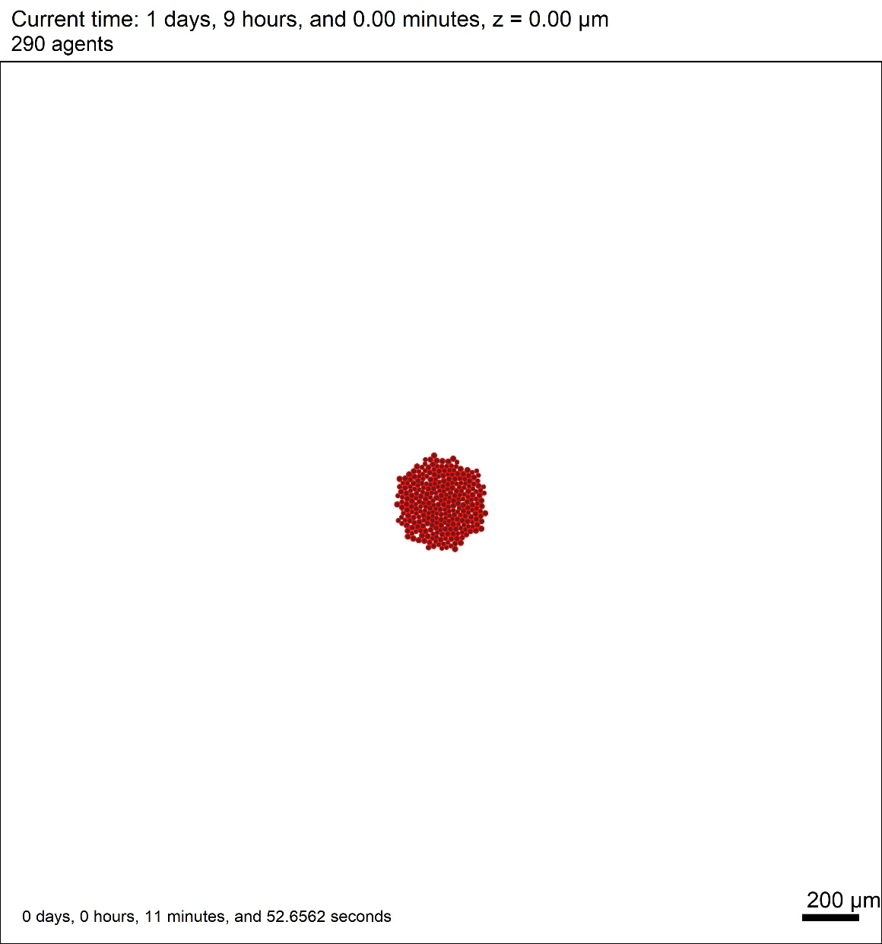
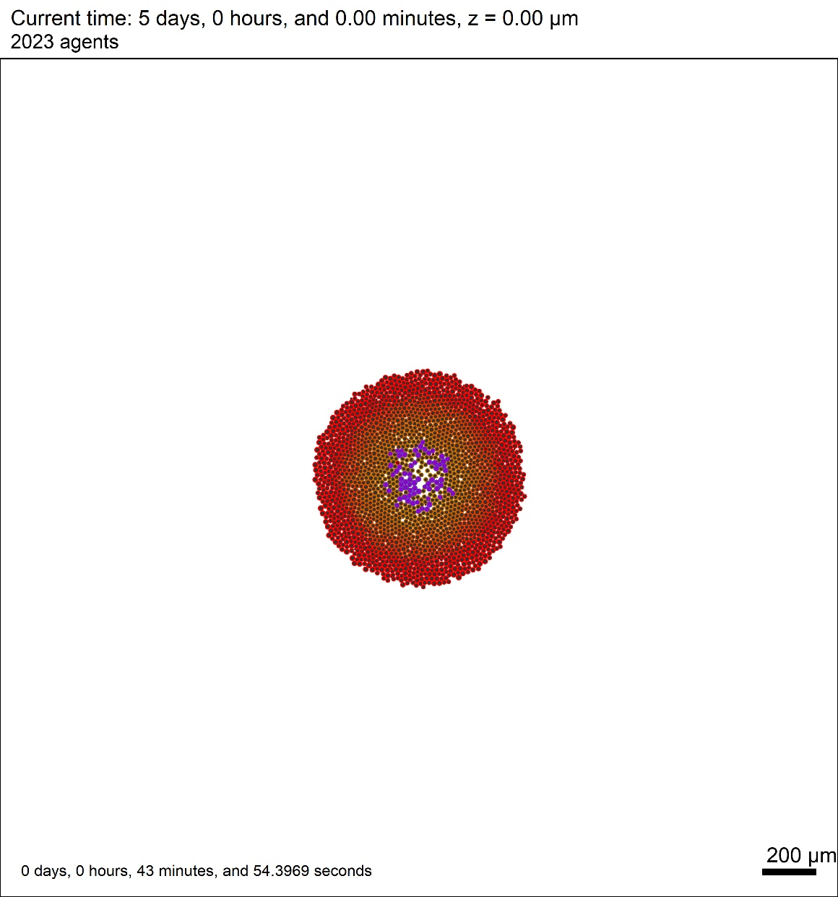
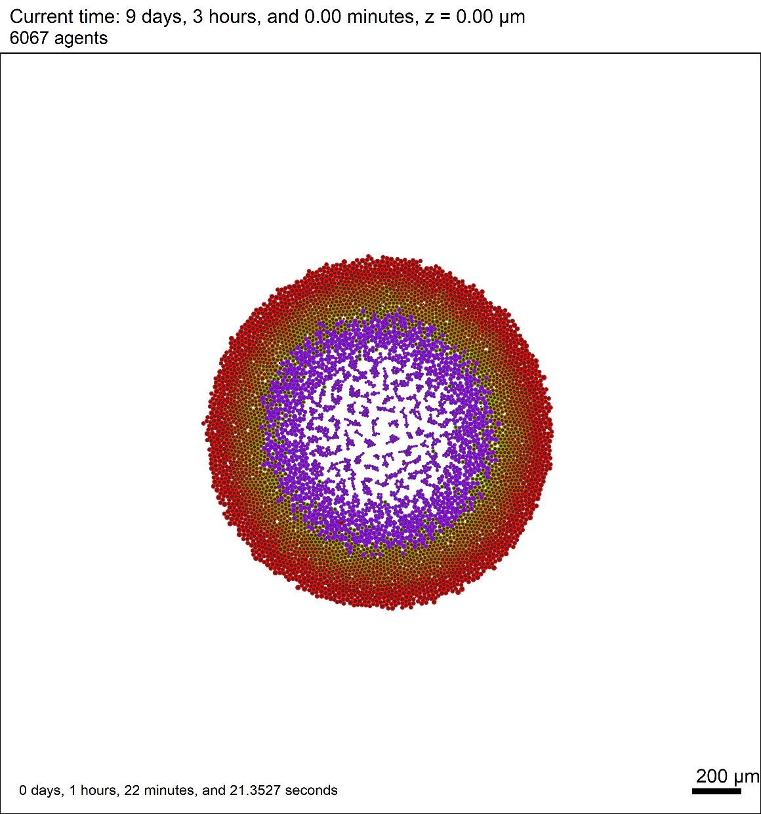
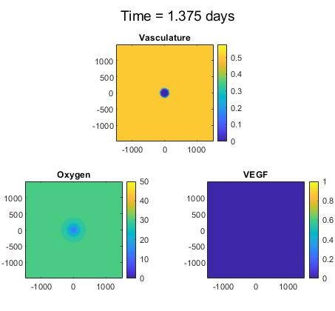
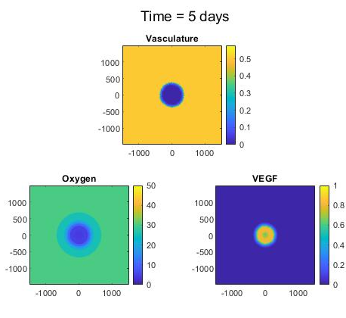
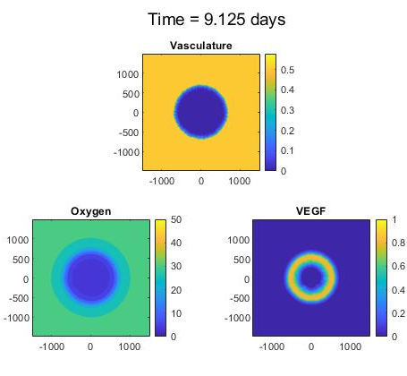
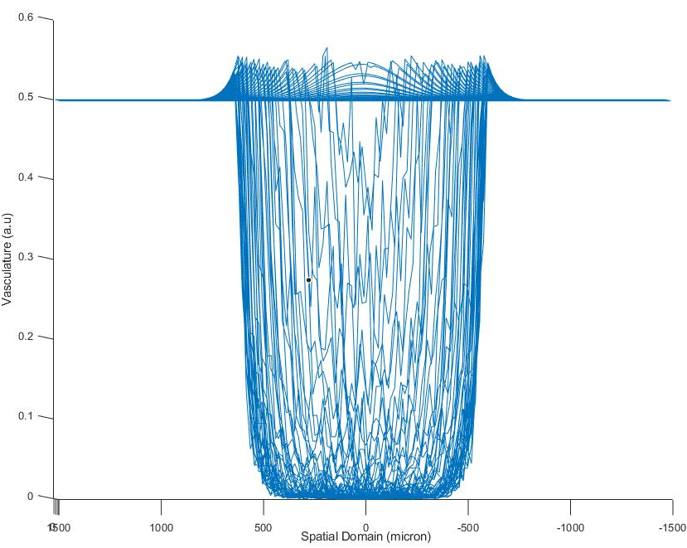


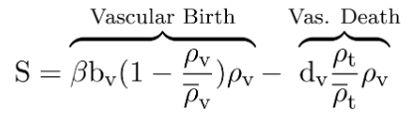



Modeling Angiogenesis in Hypoxic Breast Cancer Tumors
Kali Konstantinopoulos¹, Timothy Mahajan¹, Furkan Kurtoglu¹, John Metzcar¹, Daniele Gilkes², Paul Macklin¹
1) School of Informatics, Computing, and Engineering, Indiana University
2) School of Medicine, John Hopkins University
Introduction
Results
Hypoxic conditions occur in the center of tumor after tumor cells use and deplete oxygen.
Hypoxic cells secrete signaling chemicals to induce vascularization, such as vascular epithelial growth factor (VEGF).
Tumor has a necrotic core that has nearly no oxygen.
Cellular layering is formed as:
Necrotic, Hypoxic, Normoxic
VEGF concentration through tumor has ring-like distribution which is consistent with literature³.
A small vasculature accumulation near to tumor is observed. This was an expected behavior in order to modeling equations.
Methods
This model is developed with using agent-based multicellular system simulator which is called PhysiCell¹.
Cells are changing behavior according to oxygen level. After they become hypoxic, their genes are regulated.
Our model accounts for this vascularization by increasing VEGF secretion by hypoxic cells.
Vasculature is controlled by three mechanisms, which are grow, death, and advective flux.
Blood supplies or uptakes metabolites from microenvironment according to blood target values.
Future Work
Acknowledgements
National Science Foundation (Award 1720625),
National Institutes of Health (U01-CA232137-01),
Breast Cancer Research Foundation
Jayne Koskinas Ted Giovanis Foundation for Health and Policy.
This model will be uploaded to NanoHUB to be able to run in cloud with user interface².
Also, angiogenesis will be an external module that can be added to simulation which will be build in NanoHUB.
References
[1] PhysiCell: An open source physics-based cell simulator for 3-D multicellular systems. Ghaffarizadeh A, Heiland R, Friedman SH, Mumenthaler SM, Macklin P. PLOS Computational Biology 14(2): e1005991. doi: 10.1371/journal.pcbi.1005991 (2018)
[2] xml2jupyter: Mapping parameters between XML and Jupyter widges. Heiland R, Mishler D, Zhang T, Bower E, Macklin P. bioRxiv 601211; doi: 10.1101/601211 (2019)
[3] Experimental and computational analyses reveal dynamics of tumor vessel cooption and optimal treatment strategies C Voutouri, N D. Kirkpatrick, E Chung, F Mpekris, J W. Baish, L L. Munn, D Fukumura, T Stylianopoulos, R K. Jain: PNAS: https://doi.org/10.1073/pnas.1818322116

